Slide 1
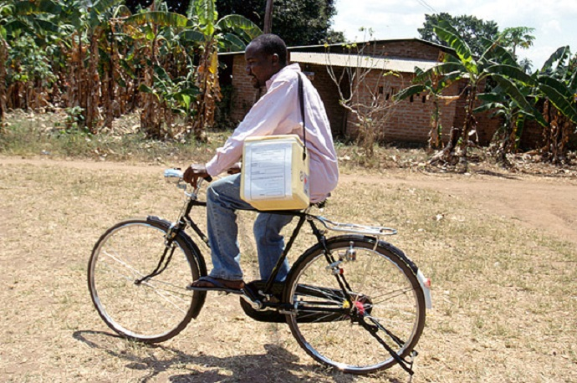
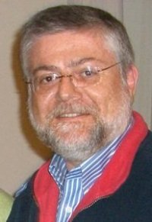
Computing and Global Health Lecture 5 Logistics
Winter 2015
Richard Anderson

Slide 2
Today’s topics
Ron Pankiewicz, Village Reach
GAVI Supply Chain Strategy
Logistics requirements
Logistics processes
Forecasting
Delivery
Ensuring product quality

Slide 3
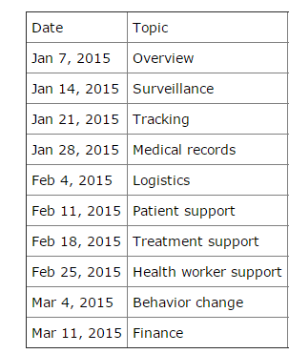
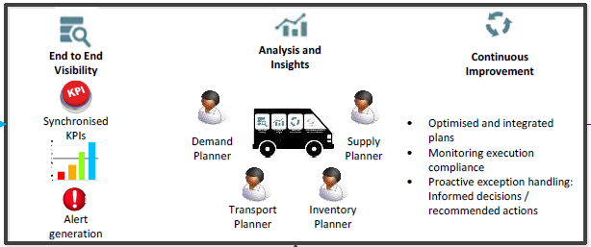
Readings and Assignments
Logistimo
SMS For Life (to assigned)
Assignment 5: Design a data collection system for a Visibility & Analytics Network
Assignment 6: Develop a syntax for an SMS reporting system

Slide 4
GAVI Supply Chain Slides

Slide 6
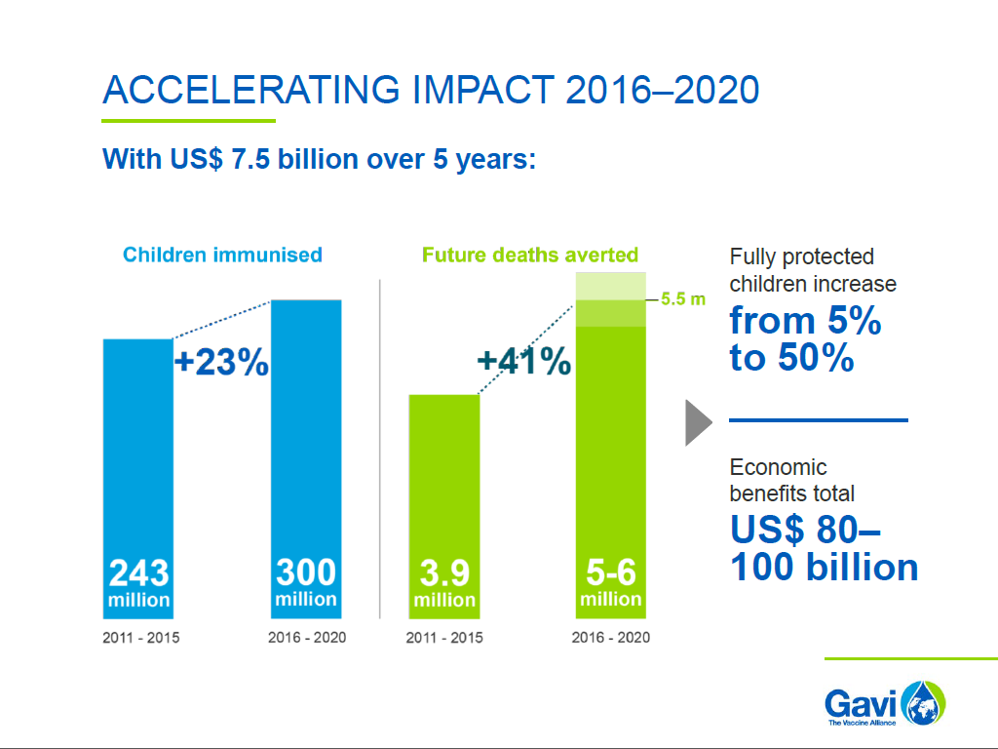
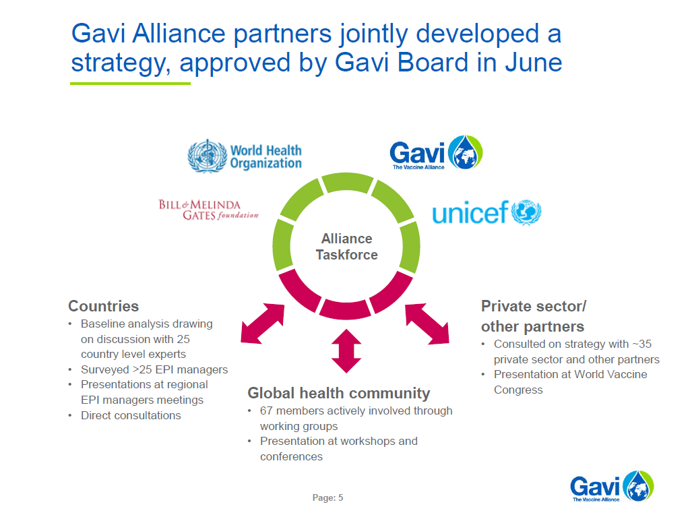

Slide 9
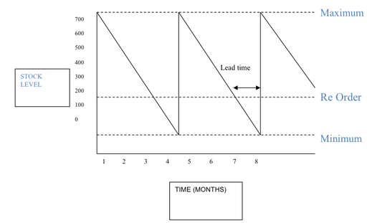
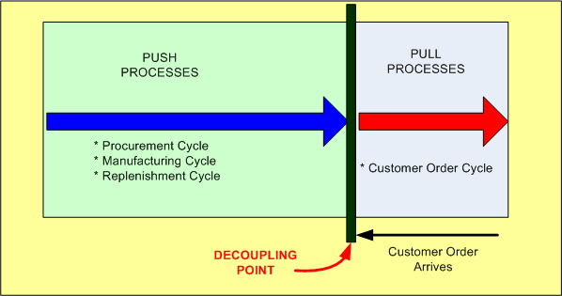
Supply Chain and Logistics
Supply chain 101
Push process
Pull process

Slide 10
Global health logistics
Large scale public sector
National scale distribution
Usually externally sourced products
Commercial or non-commercial goods
Multiple financing models
Local logistics
Regional or NGO distribution of goods

Slide 11
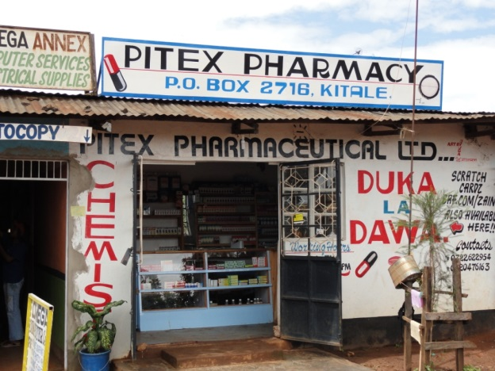
Private sector
We will ignore the private sector, but . . .
Some LMIC engage private sector in logistics
Some goods are available both in public system and in the markets
Parallel public and private networks

Slide 12
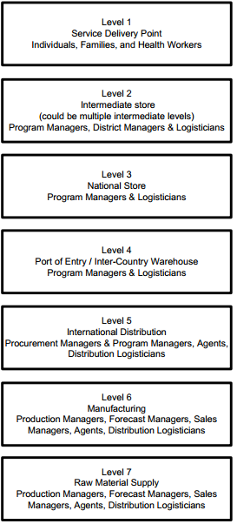
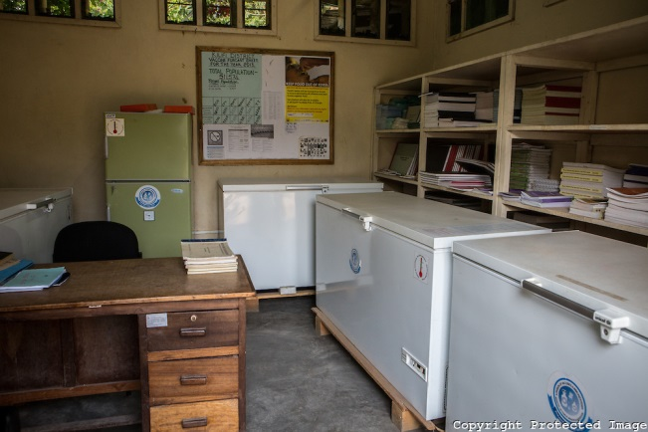
Basic logistics models
Multiple levels
National
Regional
Facility

Slide 13
Logistics Requirements
Requirement derived from country workshops and visits
Country independent requirements
What is common across countries

Slide 14
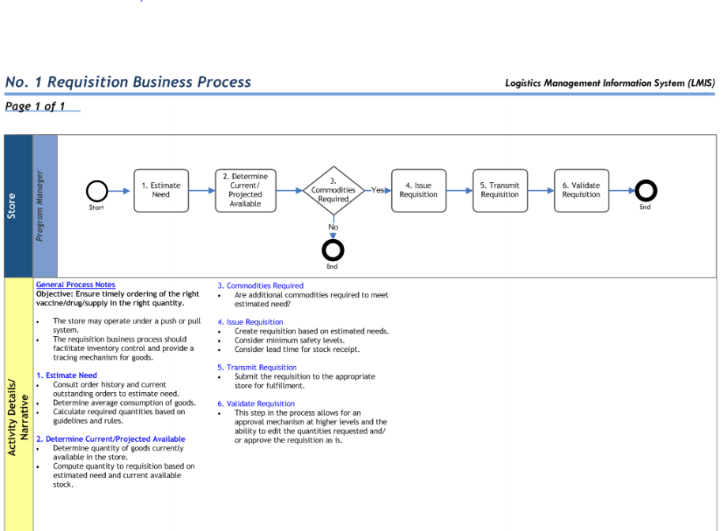
Business processes

Slide 15
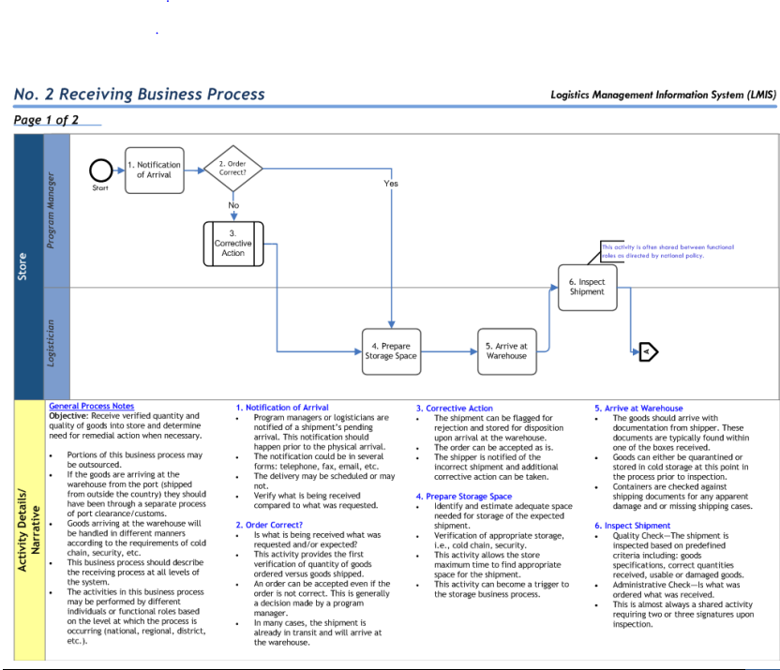
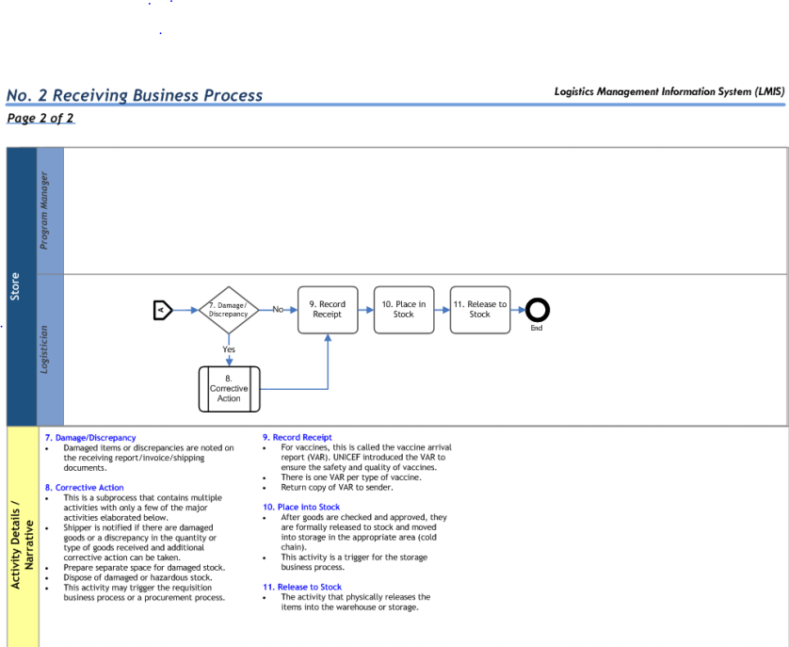
Business Processes

Slide 16
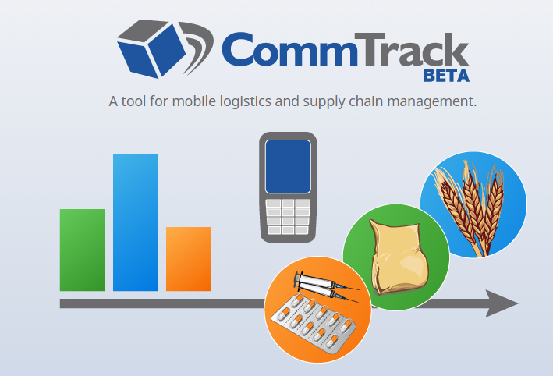
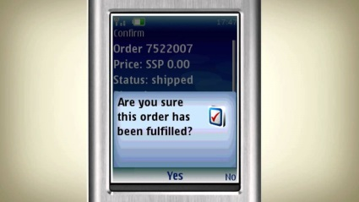
Computing and logistics
Tracking
Visibility of Inventory
Management of Transactions
Warehouse management
Forecasting
Alerts
Supply chain optimization

Slide 17
Global health logistics vs. corporate
Proctor and Gamble
Tanzania EPI
Daily deliveries
Centralized control
Thousands of products
End to end visibility
Quarterly or monthly deliveries
Decentralized system
Small number of products
Single level visibility

Slide 18
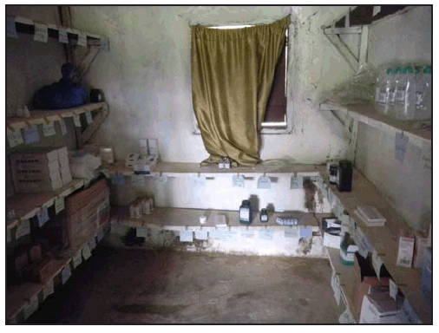
Logistics challenges
Service delivery – stocks not available
Other issues
Overstock
Delivery timing
Lost stock and spoilage
Transportation costs

Slide 19
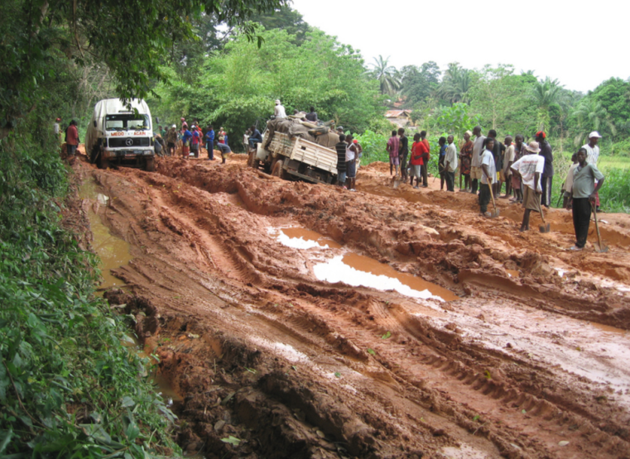
Causes of stock outs
Insufficient overall supply
Misallocation
Lack of funds
Lack of transport
Demand variation
Delay in transport
Improper ordering
Spoilage
Leakage

Slide 20
Visibility and analysis
Goals
Components
Planning
Delivery
Quality of product
Quality of supply chain

Slide 21
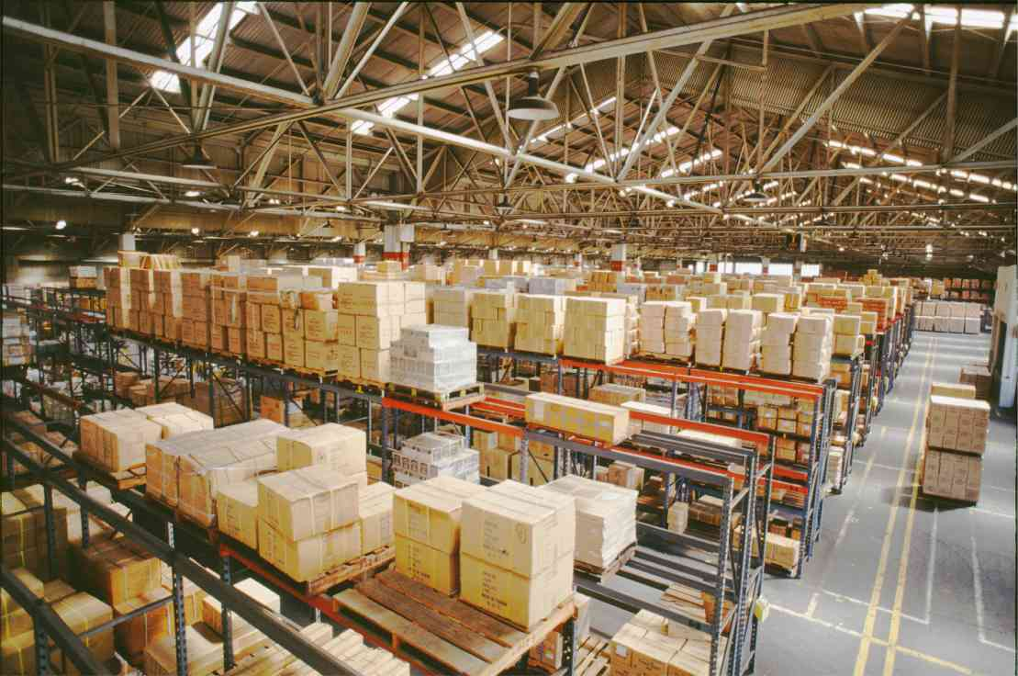
Planning
How do you know how much stuff to order

Slide 22
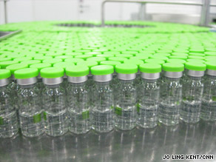
EPI Forecasting
Vaccine demand =
Doses * Population * Coverage * Supply Period / (52 * (1 – Wastage))
Min Stock =
Doses * Population * Coverage * Reserve Period / (52 * (1 – Wastage))
Max Stock = Vaccine demand + Min Stock

Slide 23
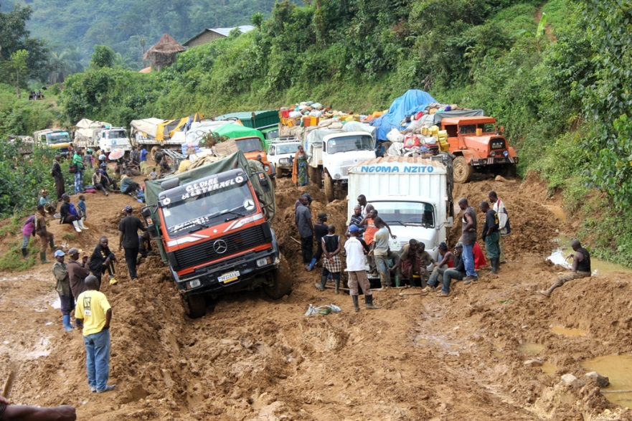
Delivery
Receive order
Approve order
Arrange transport
Pack order
Send shipment
Receive shipment
Verify / record shipment
Unpack shipment
Store shipment

Slide 24
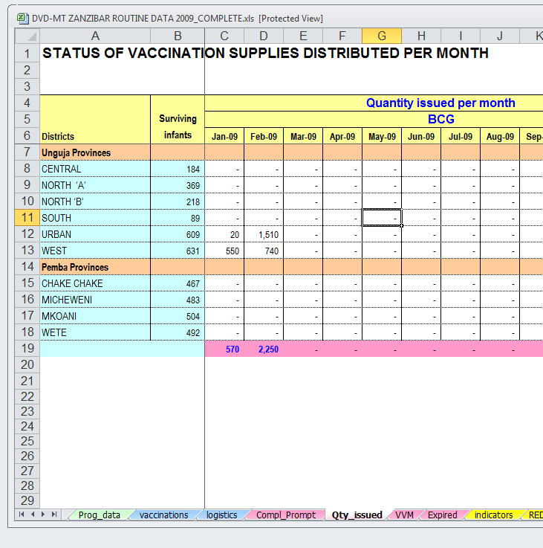
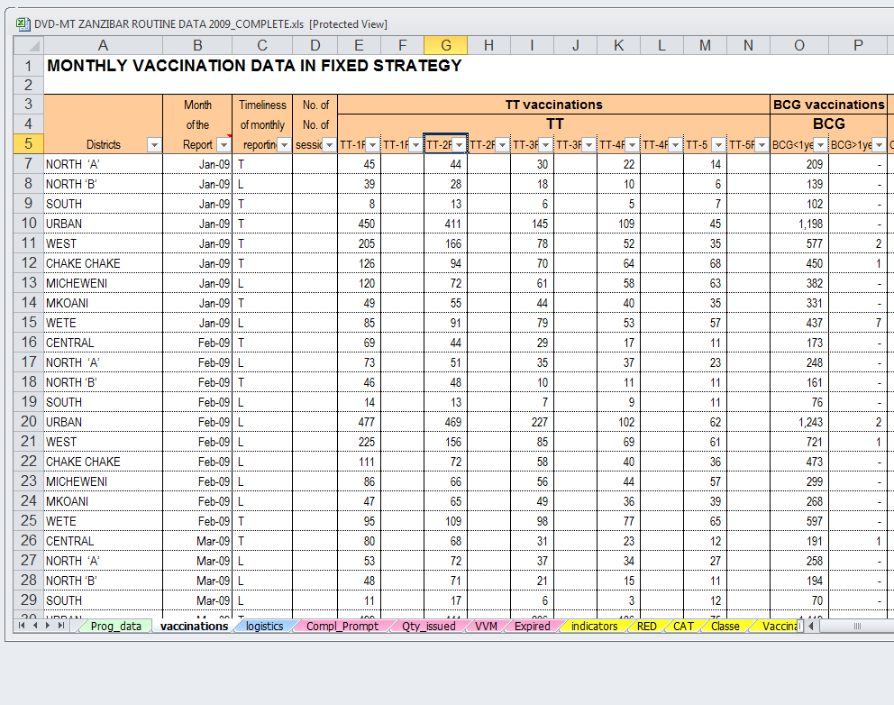
DVDMT Reporting

Slide 25
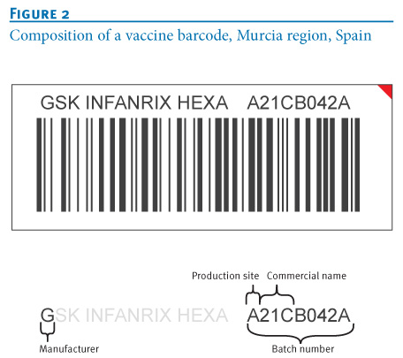
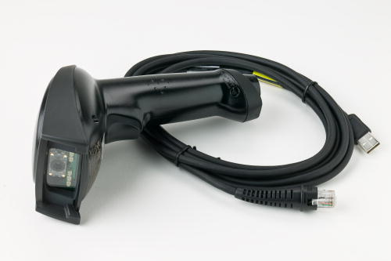
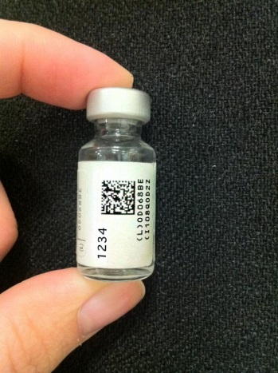
Bar coding

Slide 26
Stock data reporting
Regular reports of stock levels to SMS sent to a server
SMS for Life
Reporting project supported by Novartis
Weekly reports of supplies of Malaria medication
Pilot studies show significant drop in stock outs
Scales quickly (reach 5000 health facilities 7 months)
Reported costs: “operational cost of less than 80 USD per health facility”

Slide 27
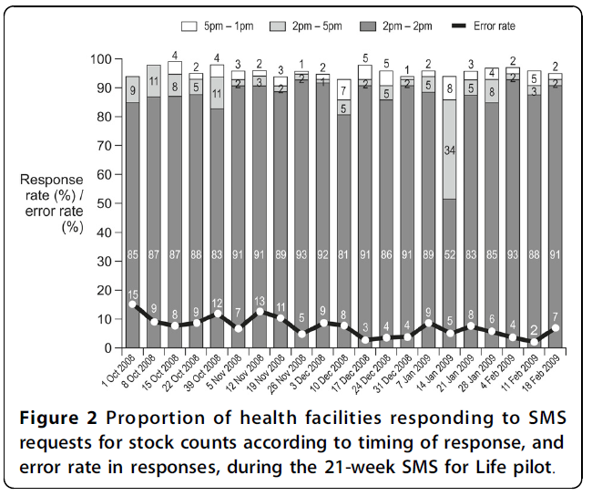
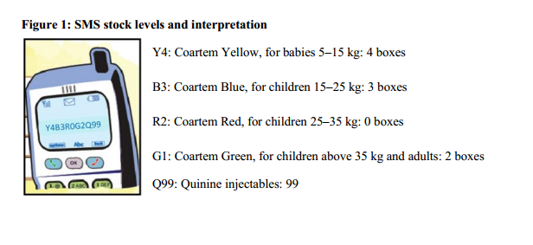
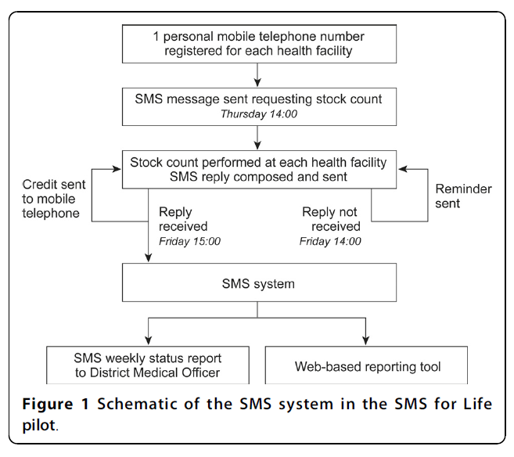
SMS for Life
The mobile phone credit was an incentive to motivate health workers to send the message on time and also to recognize the additional tasks they had to perform for the pilot above their normal workload.

Slide 28
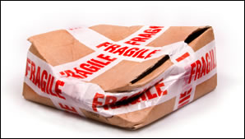
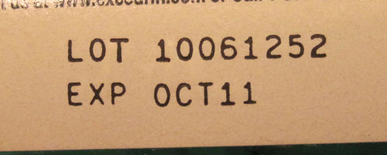
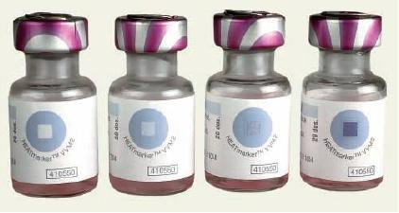
Product quality
Product spoilage
Product expiration

Slide 29
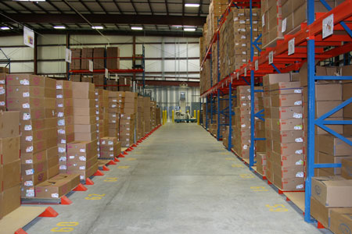
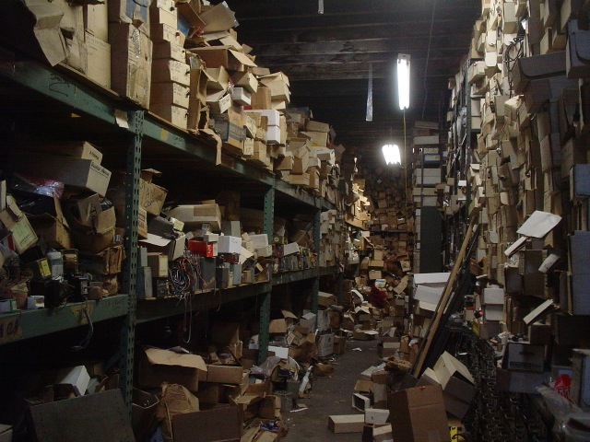
Supply chain quality
How good is the supply chain infrastructure

Slide 30
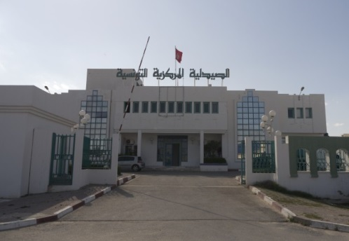
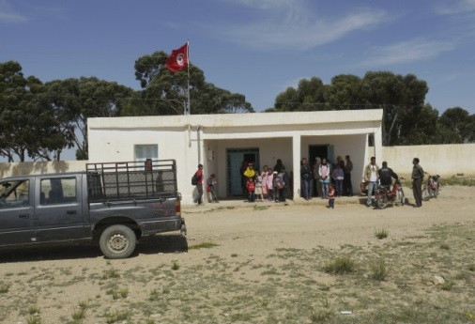
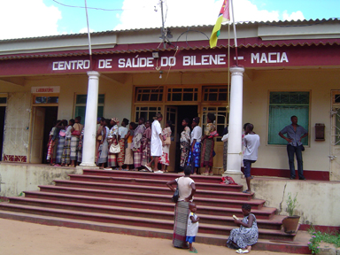
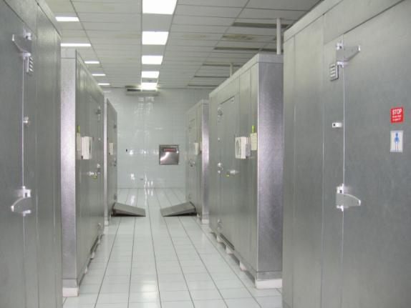
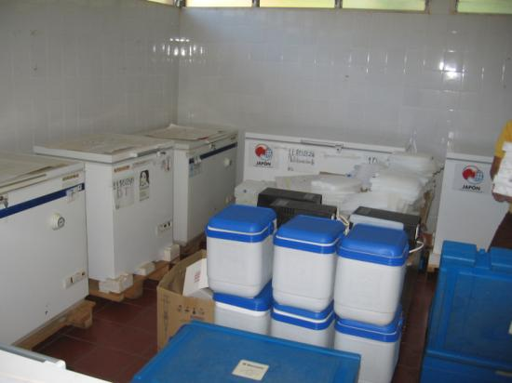
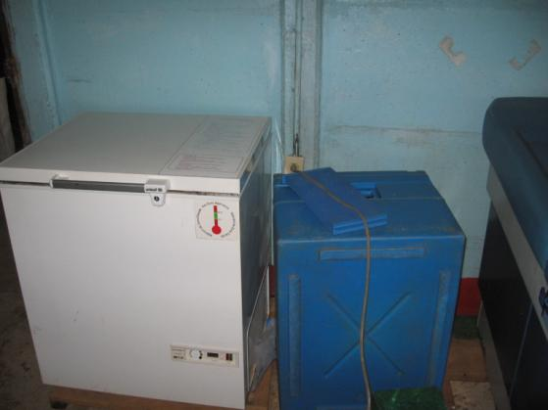
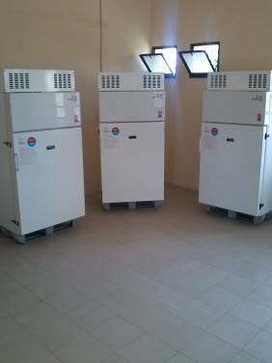
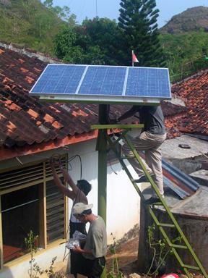
Cold chain equipment inventory
Health facility data
Refrigerators, freezers, cold room, cold box data
Vaccine and equipment reference data

Slide 31
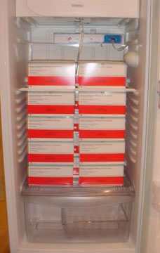
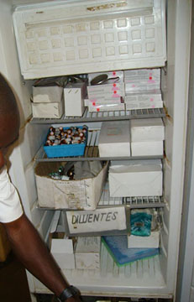
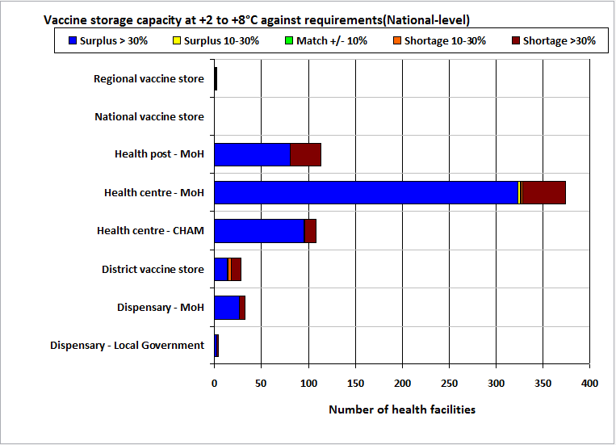
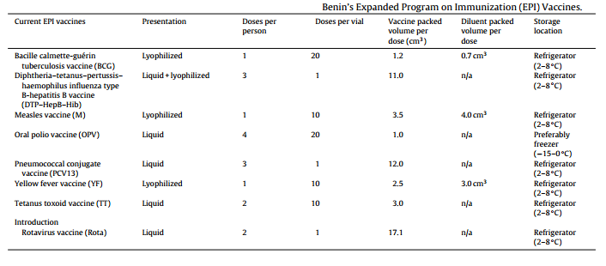
Cold chain capacity analysis
Maximum volume of storage necessary to store all vaccines
VFIC: Volume per fully immunized child
POP * VFIC / Supply Interval

Slide 32
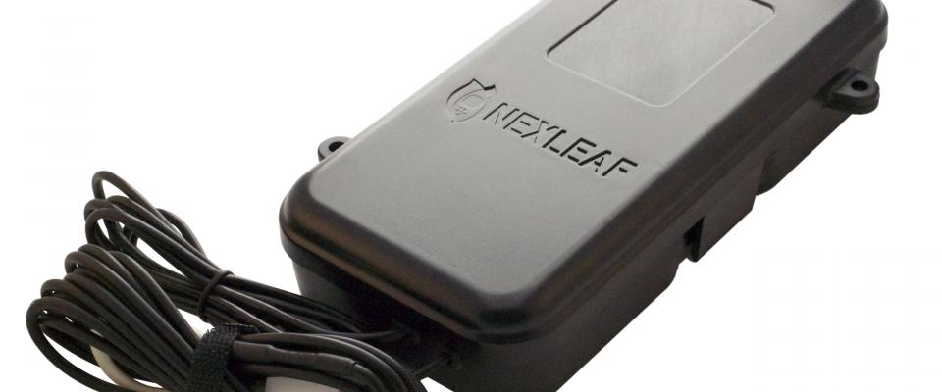
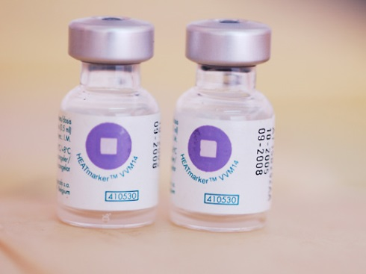
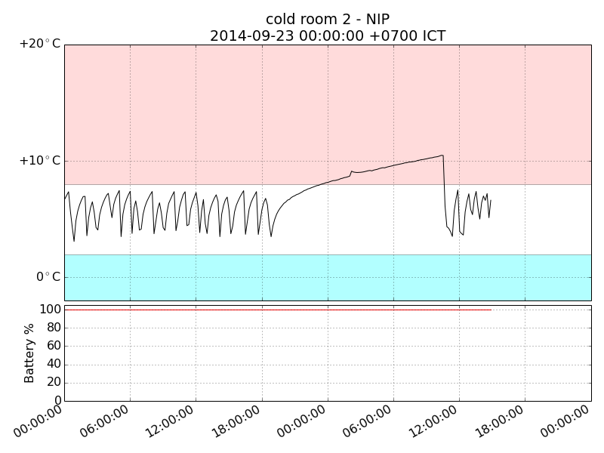
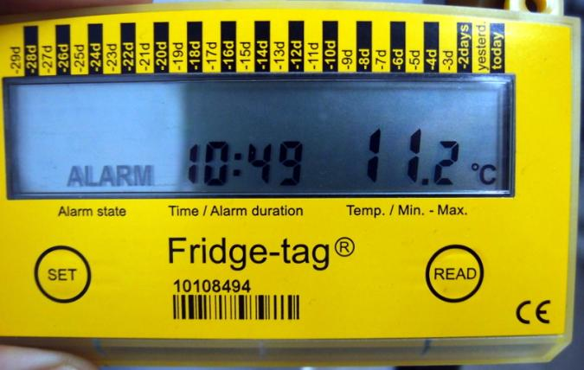
Temperature monitoring

Slide 33
Supply chain optimization

Slide 34
US Vaccine Supply Chain
1994: 64 distribution networks, 430 depots
2008: single distribution network, 4 depots

Slide 35
Supply chain modeling

Slide 36
Next week
Patient Support

